Slide 1
Introduction to Neural Networks
Lecture 08

Slide 2
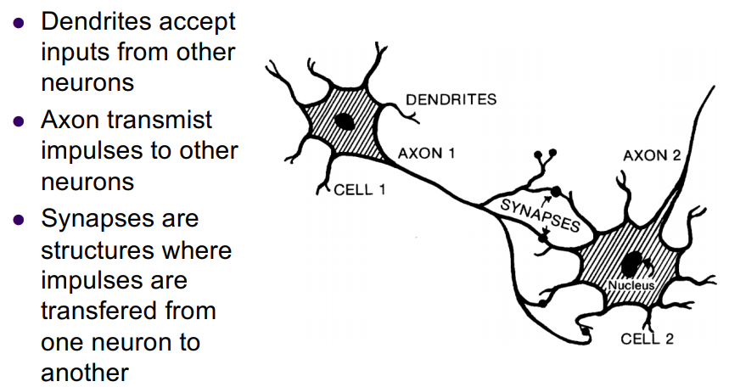
Biological Neurons

Slide 3
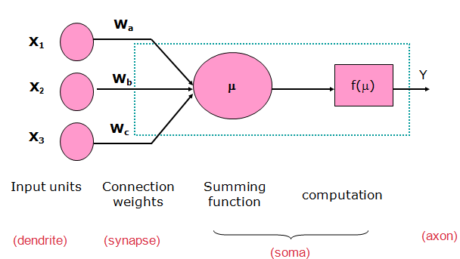
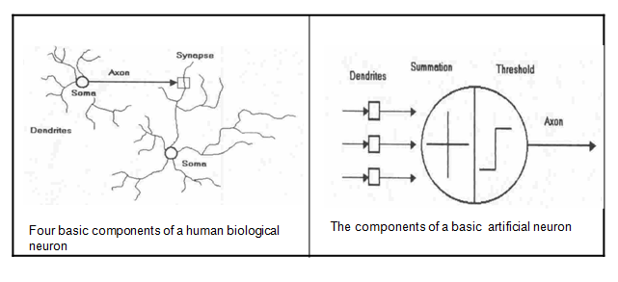
Artificial Neuron

Slide 4
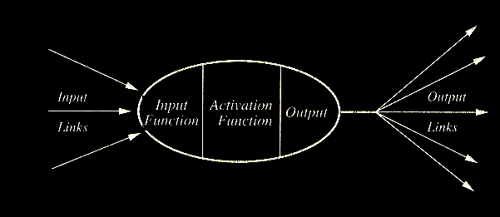
Artificial Neuron (AN)
Artificial neurons (units) are based on biological neurons.
Each neuron in the network receives one or more inputs.
An activation function is applied to the inputs, which determines the output of the neuron – the activation level.

Slide 5
Simple Computations in this AN
There are 2 types of components: Linear and Non-linear.
Linear: Input function
- calculate weighted sum of all inputs.
Non-linear: Activation function
- transform sum into activation level.

Slide 6
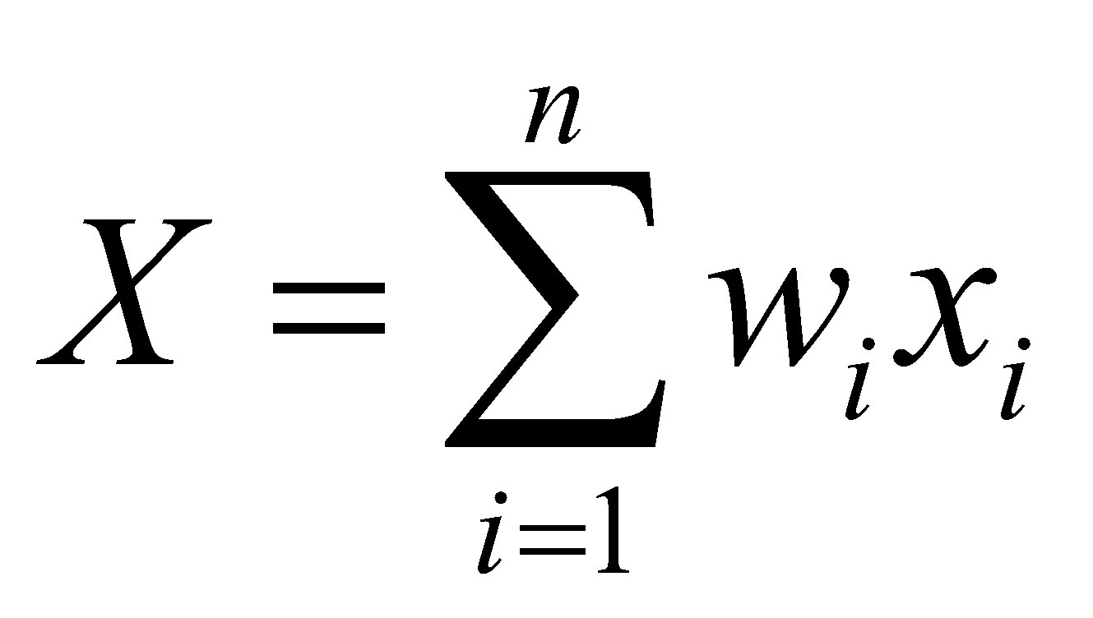
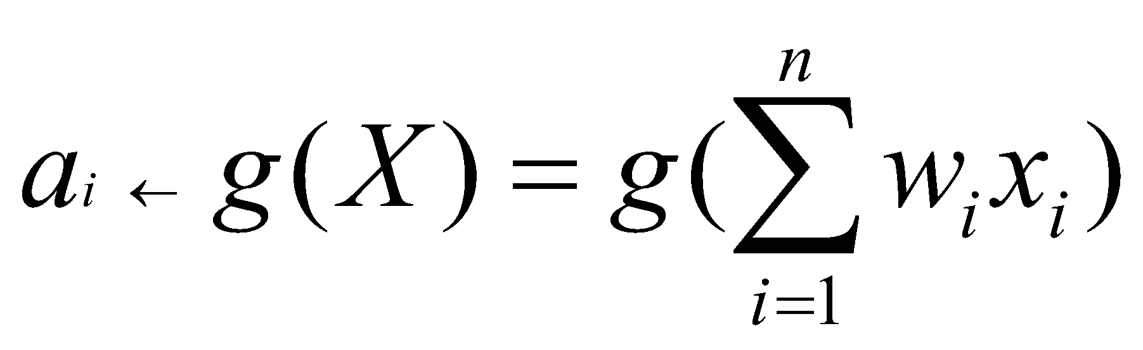
Calculations
Input function:
Activation function g:

Slide 7
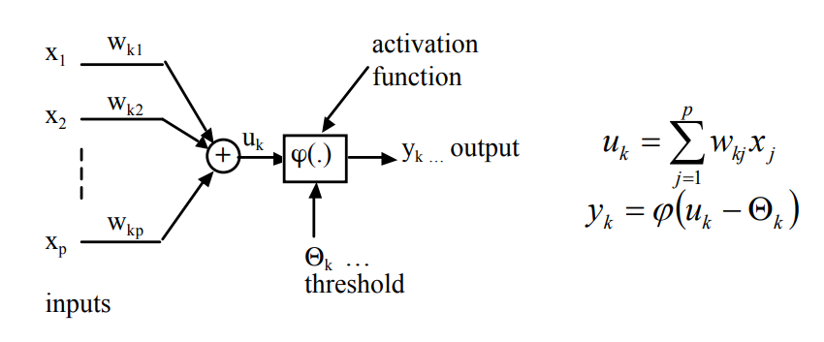
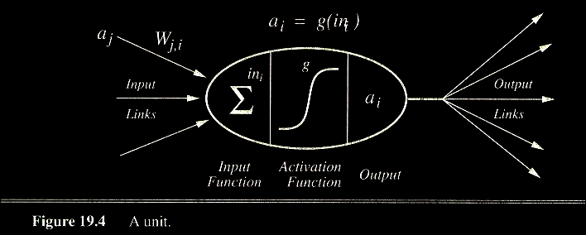
Neuron models

Slide 8
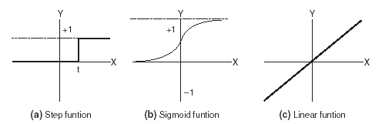
Activation Functions
- Use different functions to obtain different models.
- 3 most common choices :
1) Step function
2) Sigmoid function
3) Linear function
- An output of 1 represents firing of a neuron down the axon.

Slide 9
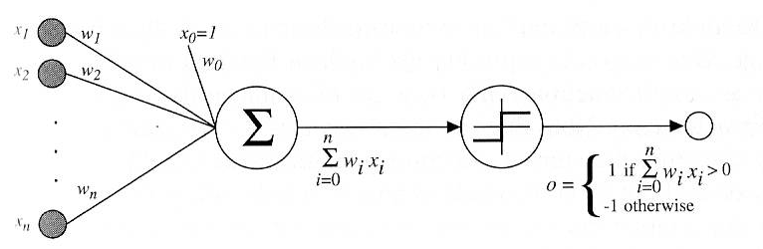
Perceptrons
A perceptron is a single neuron that classifies a set of inputs into one of two categories (usually 1 or -1).
If the inputs are in the form of a grid, a perceptron can be used to recognize visual images of shapes.
The perceptron usually uses a step function, which returns 1 if the weighted sum of inputs exceeds a threshold, and 0 otherwise.

Slide 10
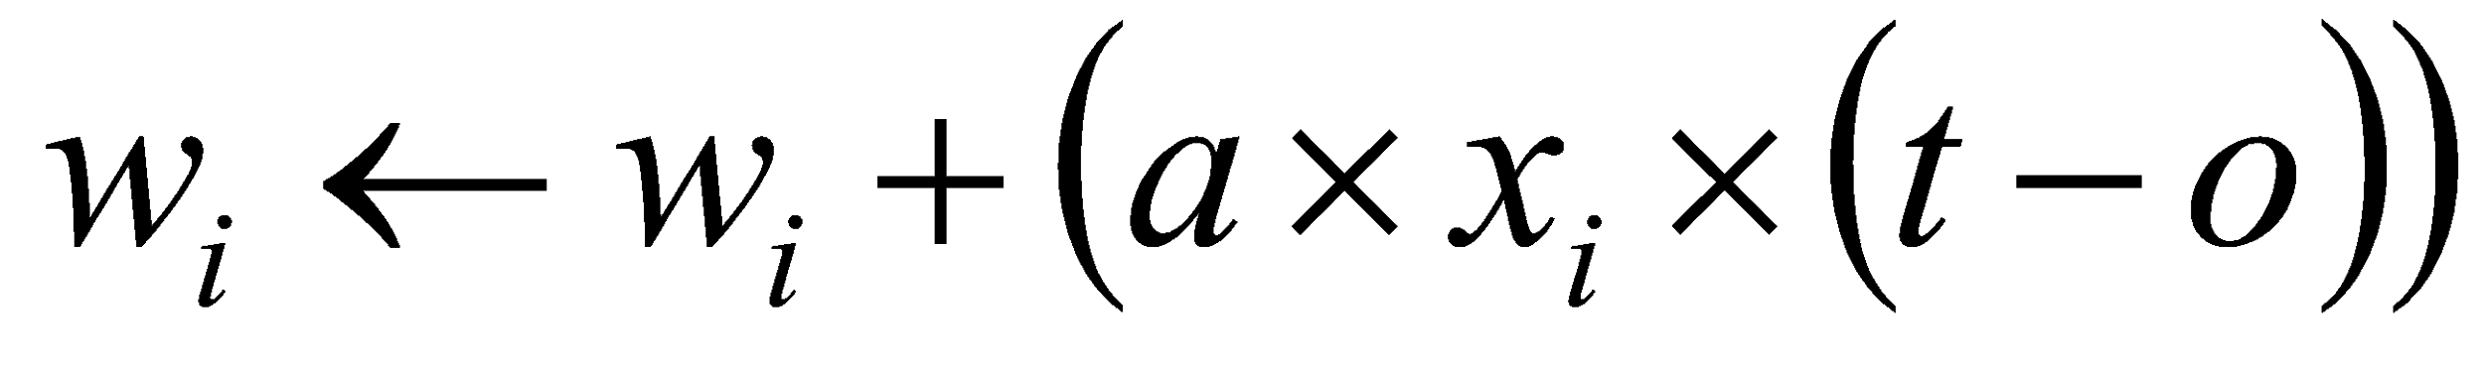
Training Perceptrons
Learning involves choosing values for the weights
The perceptron is trained as follows:
First, inputs are given random weights (usually between –0.5 and 0.5).
An item of training data is presented. If the perceptron missclassifies it, the weights are modified according to the following:
where t is the target output for the training example, o is the output generated by the perceptron and a is the learning rate, between 0 and 1 (usually small such as 0.1)
Cycle through training examples until successfully classify all examples
Each cycle known as an epoch

Slide 11
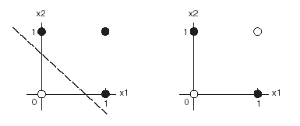
Bias of Perceptrons
Perceptrons can only classify linearly separable functions.
The first of the following graphs shows a linearly separable function (OR).
The second is not linearly separable (Exclusive-OR).

Slide 12
Convergence
Perceptron training rule only converges when training examples are linearly separable and a has a small learning constant
Another approach uses the delta rule and gradient descent
Same basic rule for finding update value
Changes
Do not incorporate the threshold in the output value (unthresholded perceptron)
Wait to update weight until cycle is complete
Converges asymptotically toward the minimum error hypothesis, possibly requiring unbounded time, but converges regardless of whether the training data are linearly separable

Slide 13
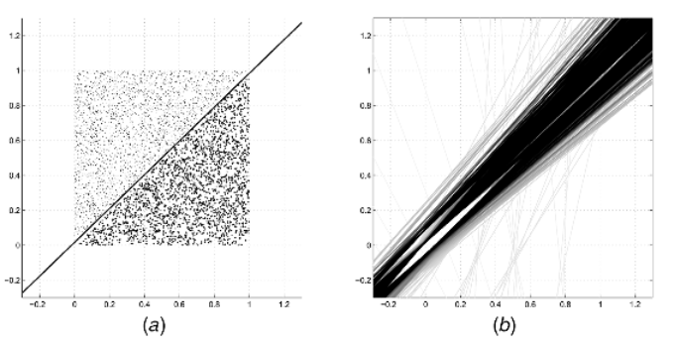
Evolution of the Class Boundary

Slide 14
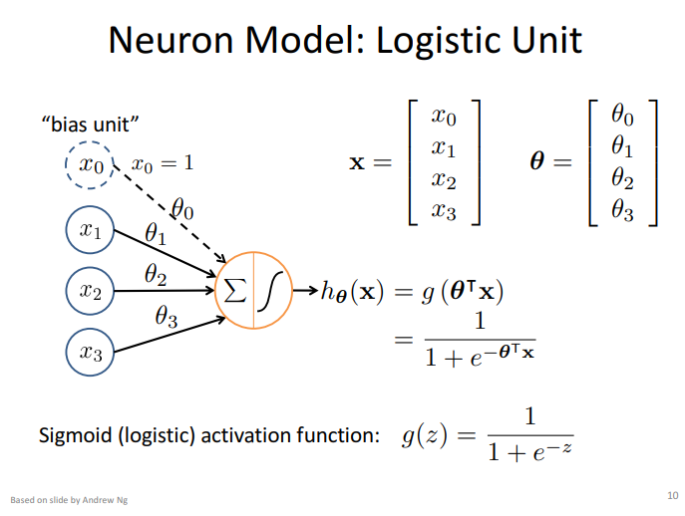

Slide 15

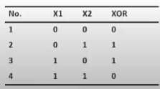
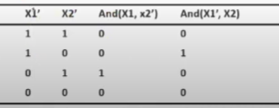
Failure to Linear Separable Class

Slide 16
Representing Boolean Function

Slide 17
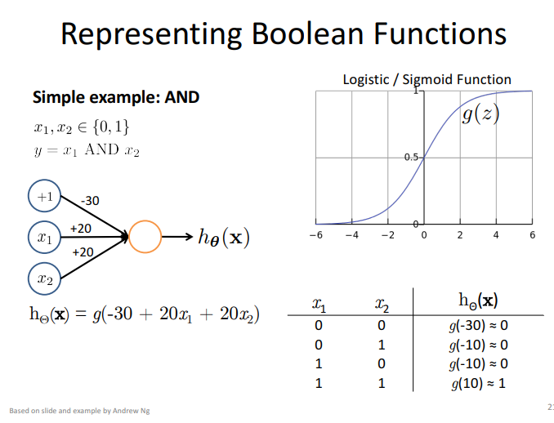

Slide 18
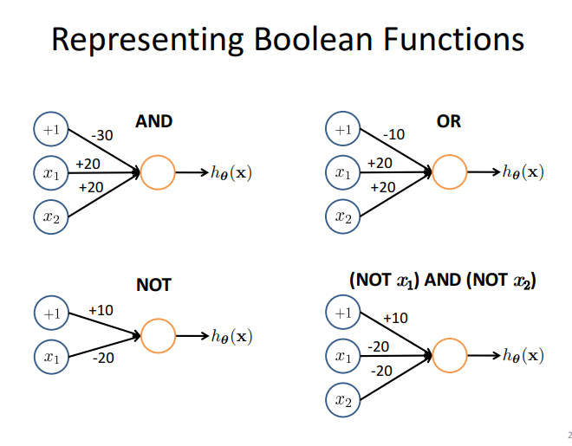

Slide 19
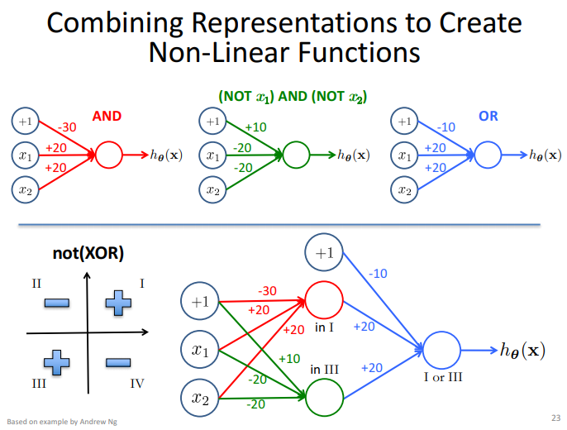

Slide 20
Capabilities of Threshold Neurons
What do we do if we need a more complex function?
Just like Threshold Logic Units, we can also combine multiple artificial neurons to form networks with increased capabilities.
For example, we can build a two-layer network with any number of neurons in the first layer giving input to a single neuron in the second layer.
The neuron in the second layer could, for example, implement an AND function.

Slide 21
Capabilities of Threshold Neurons
x₁
x₂
x₁
x₂
x_{i}
.
.
.
x₁
x₂
What kind of function can such a network realize?

Slide 22
Capabilities of Threshold Neurons
Assume that the dotted lines in the diagram represent the input-dividing lines implemented by the neurons in the first layer:
2nd comp.
1st comp.
Then, for example, the second-layer neuron could output 1 if the input is within a polygon, and 0 otherwise.

Slide 23
Capabilities of Threshold Neurons
However, we still may want to implement functions that are more complex than that.
An obvious idea is to extend our network even further.
Let us build a network that has three layers, with arbitrary numbers of neurons in the first and second layers and one neuron in the third layer.
The first and second layers are completely connected, that is, each neuron in the first layer sends its output to every neuron in the second layer.

Slide 24
Capabilities of Threshold Neurons
x₁
x₂
x₁
x₂
o_{i}
.
.
.
.
.
.
x₁
x₂
What type of function can a three-layer network realize?

Slide 25
Capabilities of Threshold Neurons
Assume that the polygons in the diagram indicate the input regions for which each of the second-layer neurons yields output 1:
2nd comp.
1st comp.
Then, for example, the third-layer neuron could output 1 if the input is within any of the polygons, and 0 otherwise.

Slide 26
Capabilities of Threshold Neurons
The more neurons there are in the first layer, the more vertices can the polygons have.
With a sufficient number of first-layer neurons, the polygons can approximate any given shape.
The more neurons there are in the second layer, the more of these polygons can be combined to form the output function of the network.
With a sufficient number of neurons and appropriate weight vectors w_{i}, a three-layer network of threshold neurons can realize any function R^{n} → {0, 1}.

Slide 27
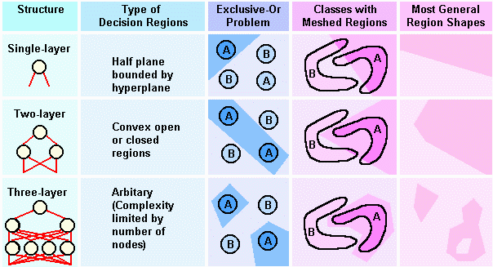
Pattern Separation and NN architecture

Slide 28
Network architectures
Network architectures (or topologies) define ways how neurons are mutually connected
Like:
Single-layer feed-forward networks (perceptron)
Multi-layer feed-forward networks (MLP)

Slide 29
Learning with hidden units
Networks without hidden units are very limited in the input-output mappings they can learn to model.
More layers of linear units do not help. Its still linear.
Fixed output non-linearities are not enough.
We need multiple layers of adaptive, non-linear hidden units. But how can we train such nets?
We need an efficient way of adapting all the weights, not just the last layer. This is hard.
Learning the weights going into hidden units is equivalent to learning features.
This is difficult because nobody is telling us directly what the hidden units should do.

Slide 30
LEARNING THE WEIGHTS OF A LOGISTIC OUTPUT NEURON

Slide 31
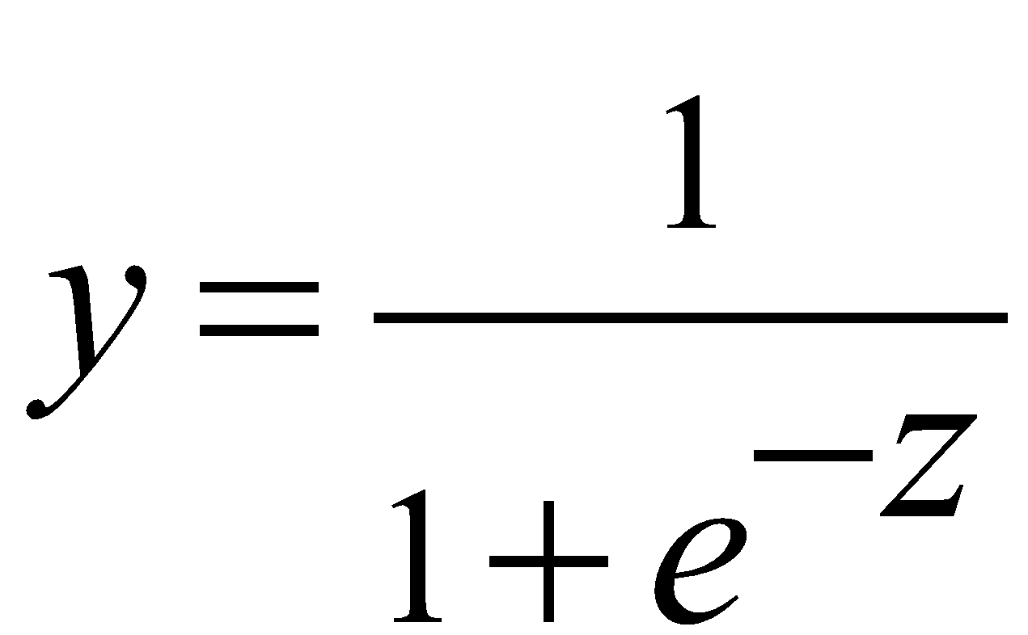
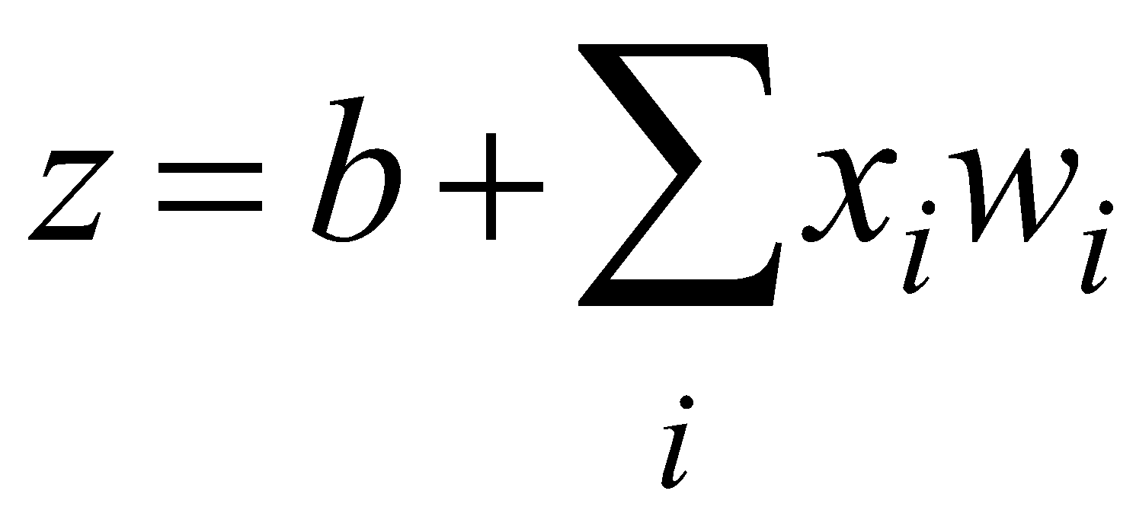


Logistic neurons
These give a real-valued output that is a smooth and bounded function of their total input.
They have nice derivatives which make learning easy.
1
0.5
0
0

Slide 32
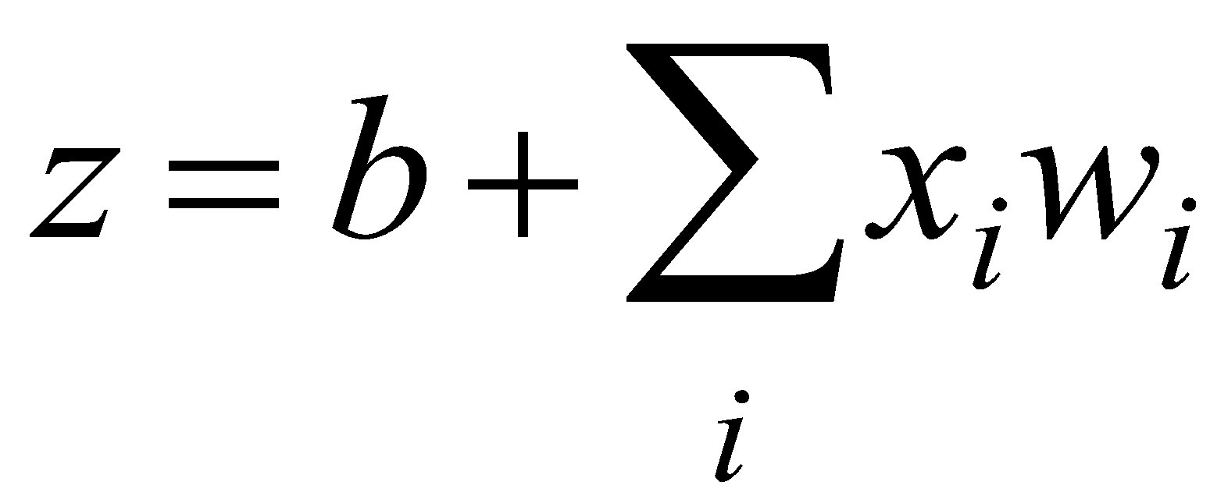
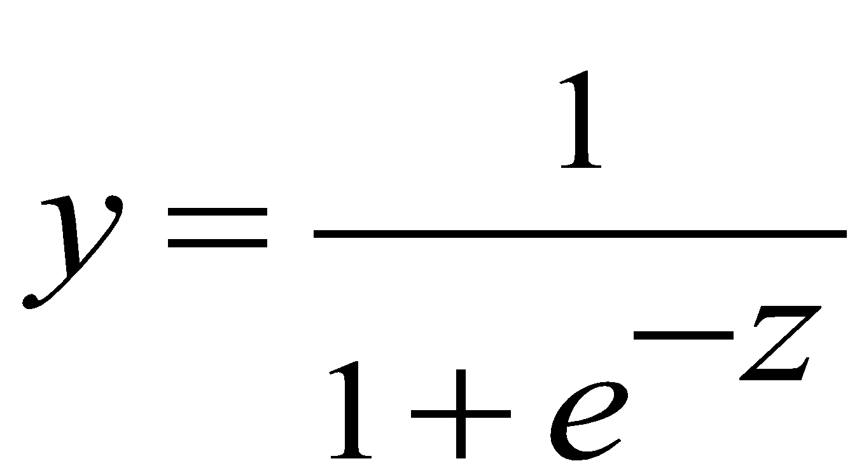
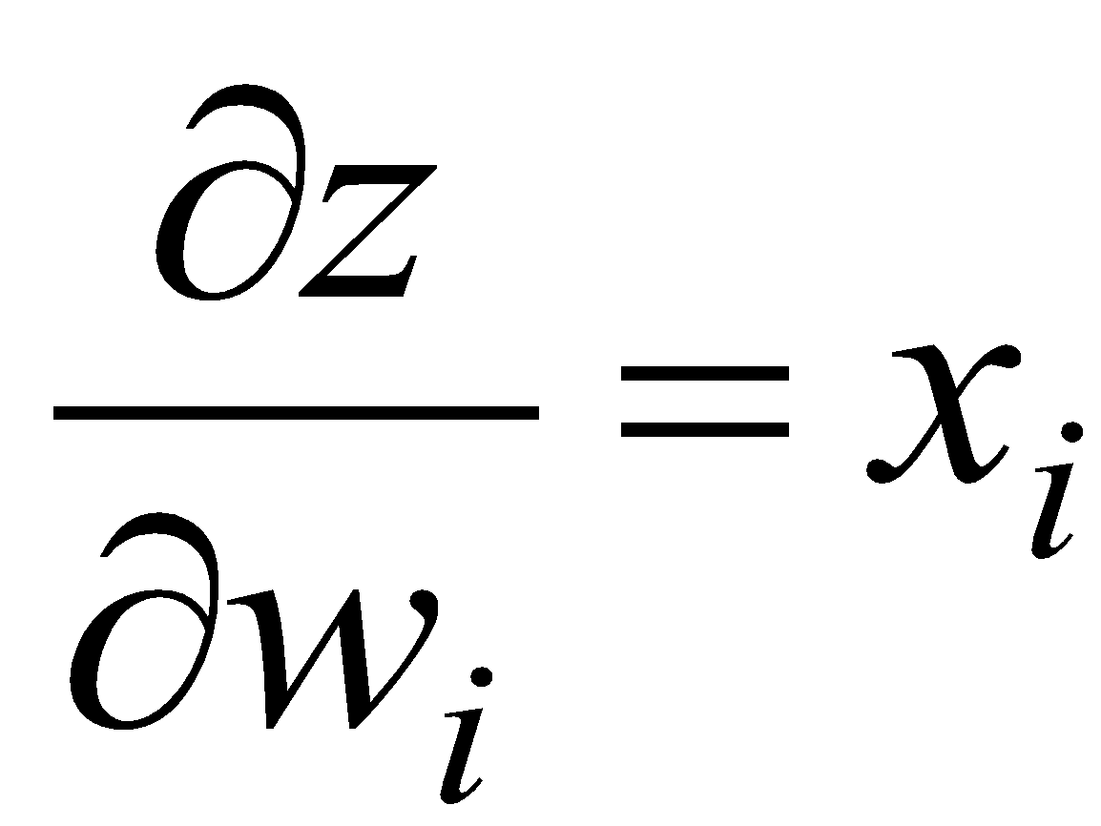
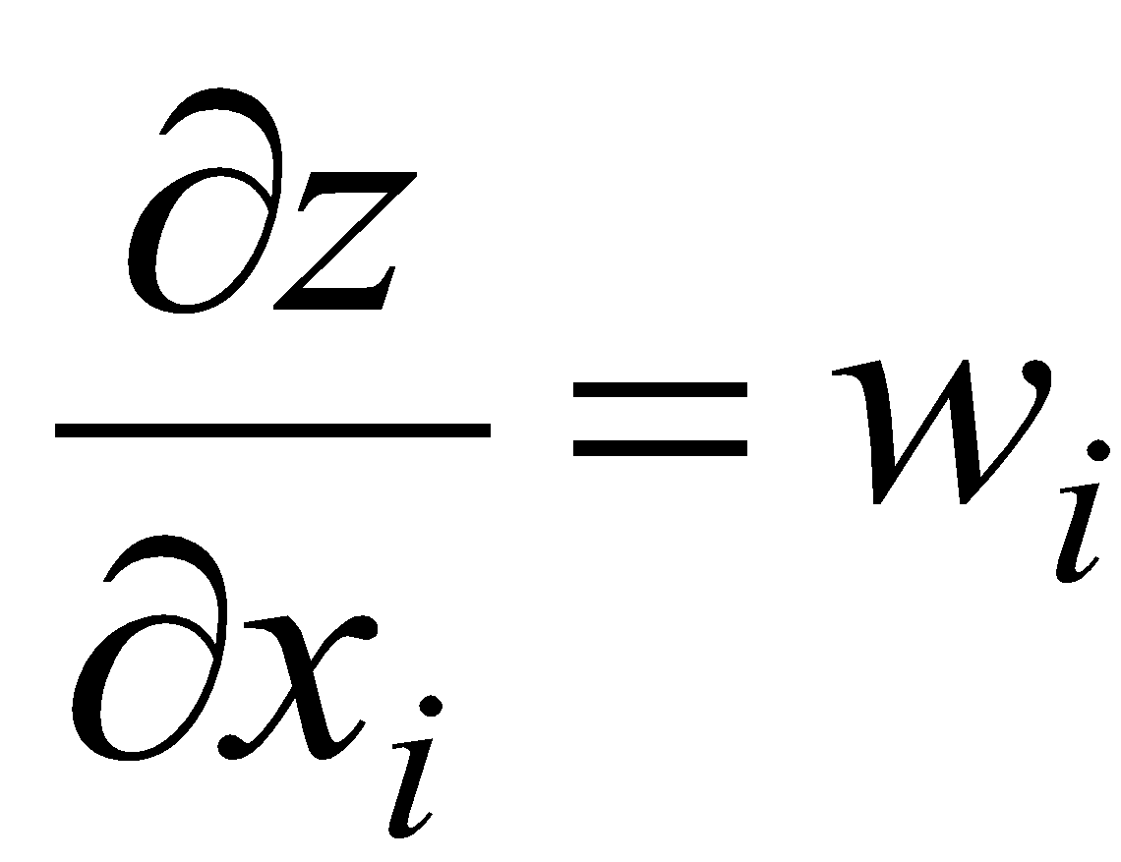
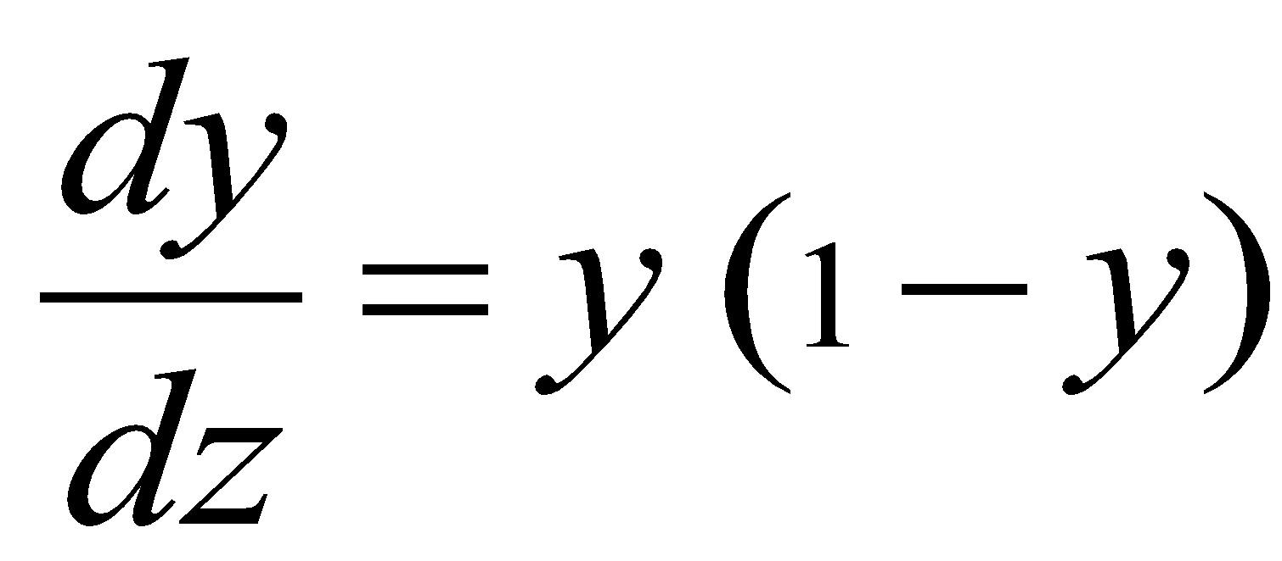
The derivatives of a logistic neuron
The derivatives of the logit, z, with respect to the inputs and the weights are very simple:
The derivative of the output with respect to the logit is simple if you express it in terms of the output:

Slide 33
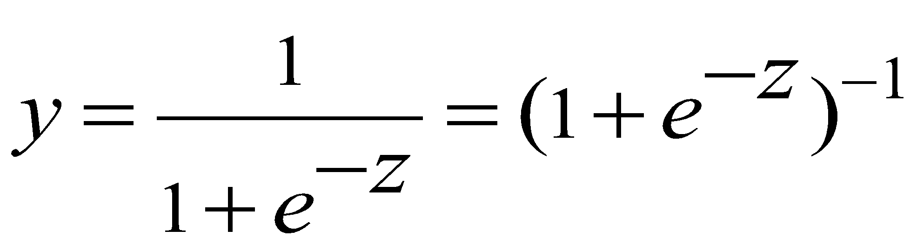
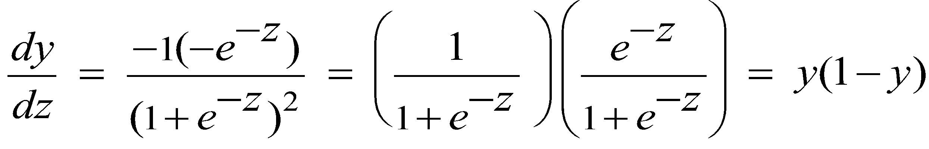
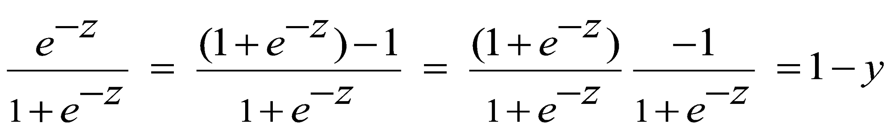
The derivatives of a logistic neuron
because

Slide 34
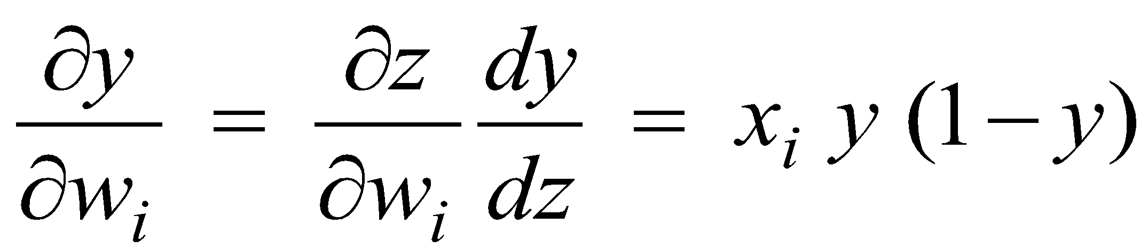
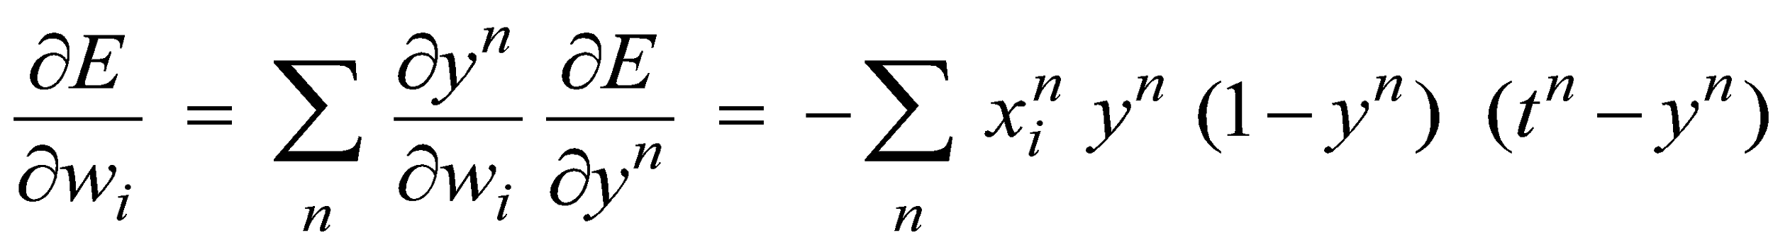
Using the chain rule to get the derivatives needed for learning the weights of a logistic unit
To learn the weights we need the derivative of the output with respect to each weight:
delta-rule
extra term = slope of logistic

Slide 35
GRADIENT DESCENT

Slide 36
Closed Form
set derivatives equal to zero and solve for parameters

Slide 37
Closed Form – why not then?
It is straight-forward to write down a set of equations, one per datum, and to solve for the best set of parameters. So why don’t we?
We want a method that can be generalized to non-convex, non-linear error models.
The analytic solution relies on it being linear and having a squared error measure.
Iterative methods are usually less efficient but they are much easier to generalize.

Slide 38
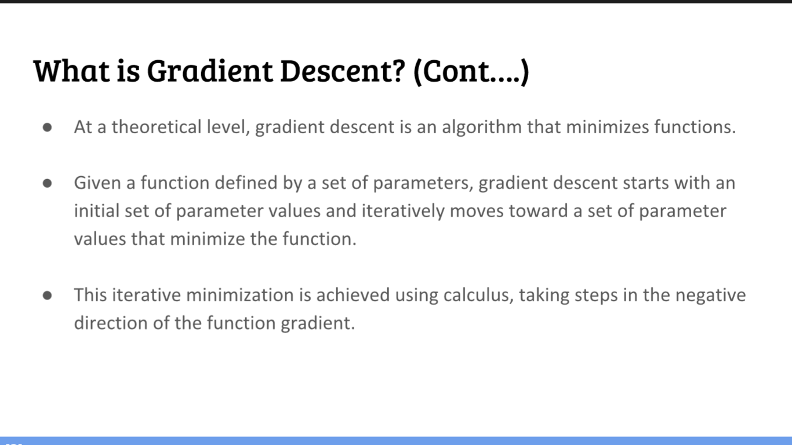

Slide 39
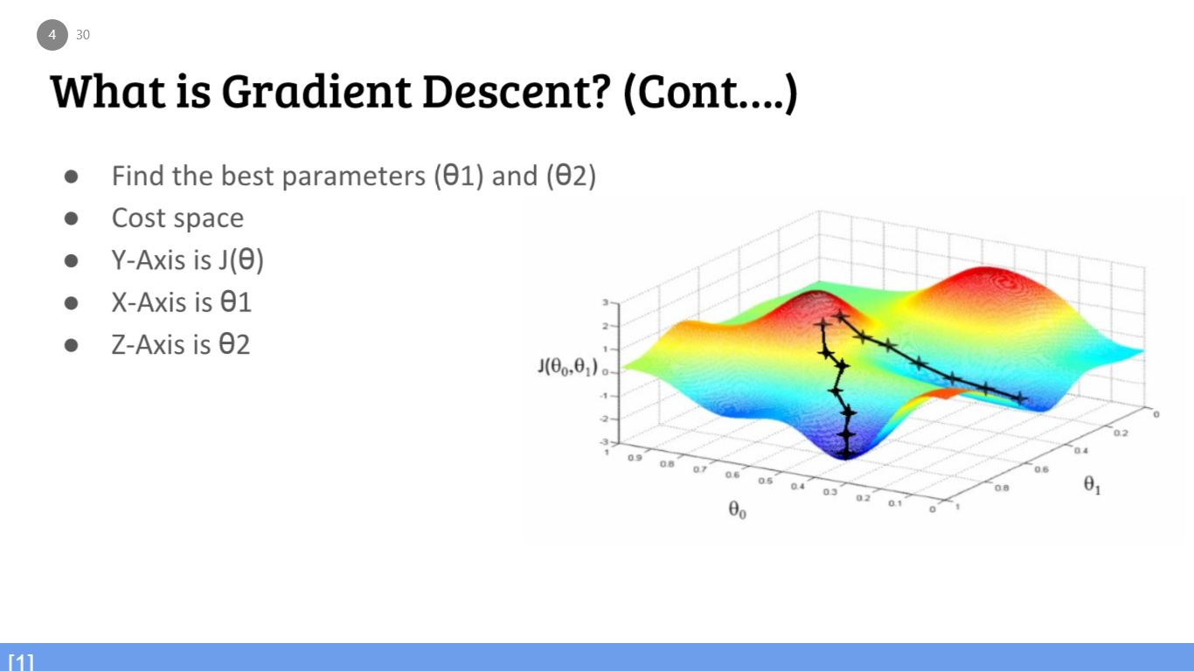

Slide 40
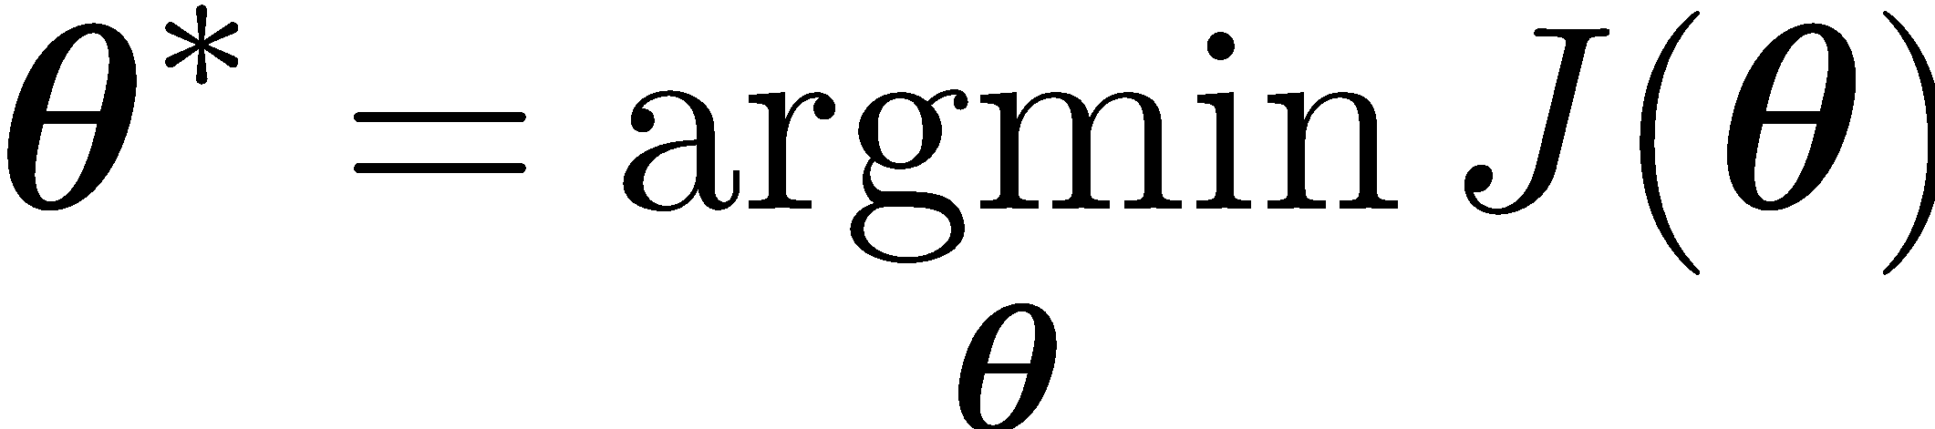
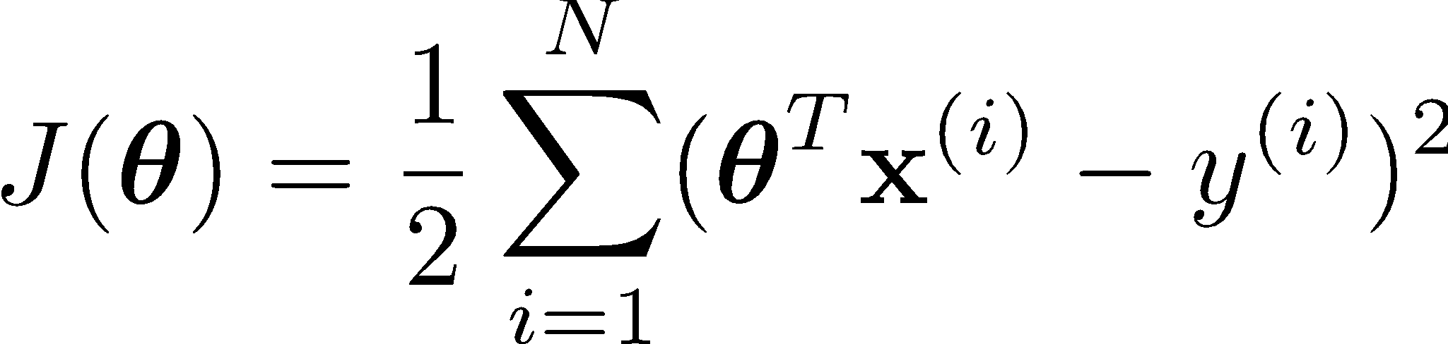
In summary (the big expressions)
Learning: finds the parameters that minimize some objective function
We minimize the sum of the squares:

Slide 41
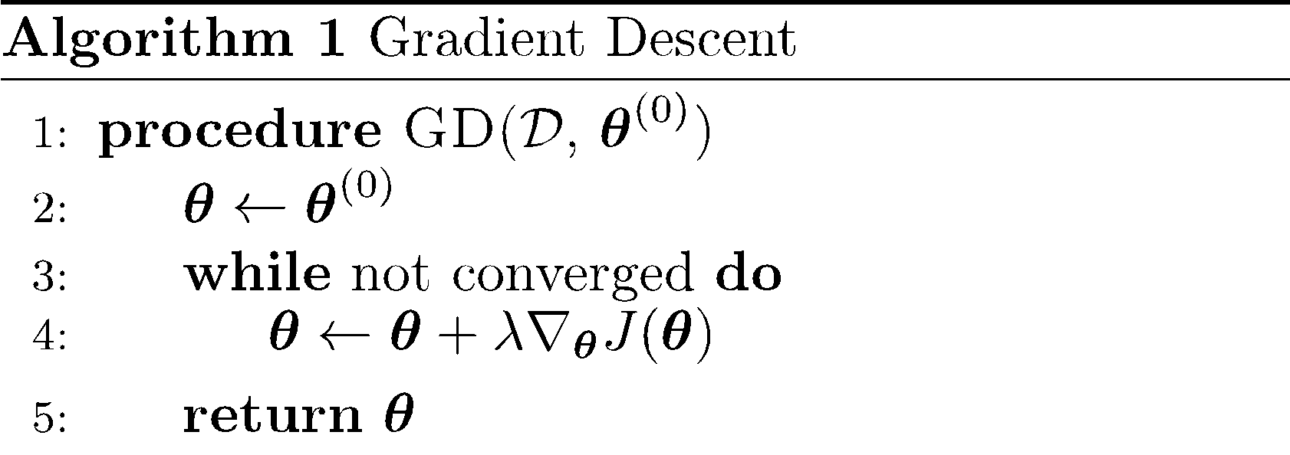
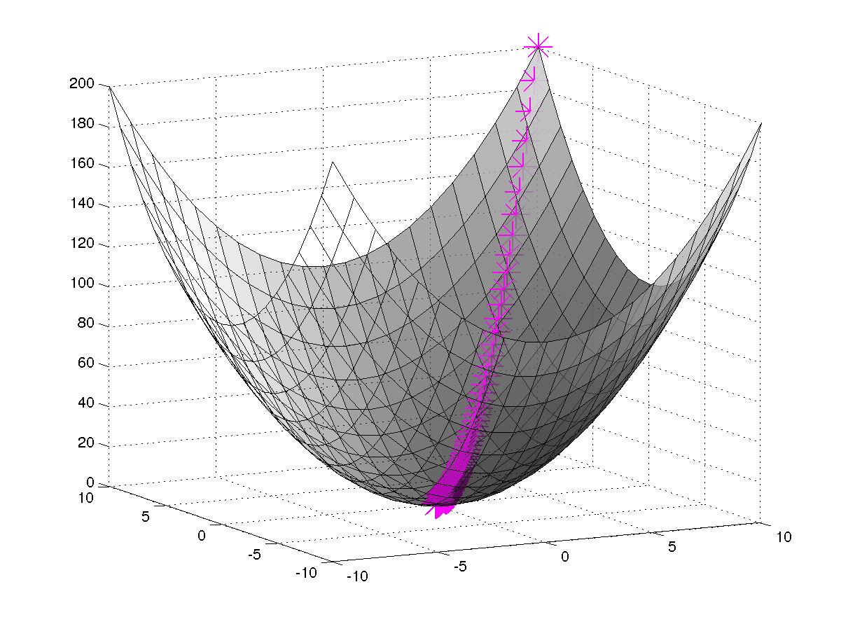
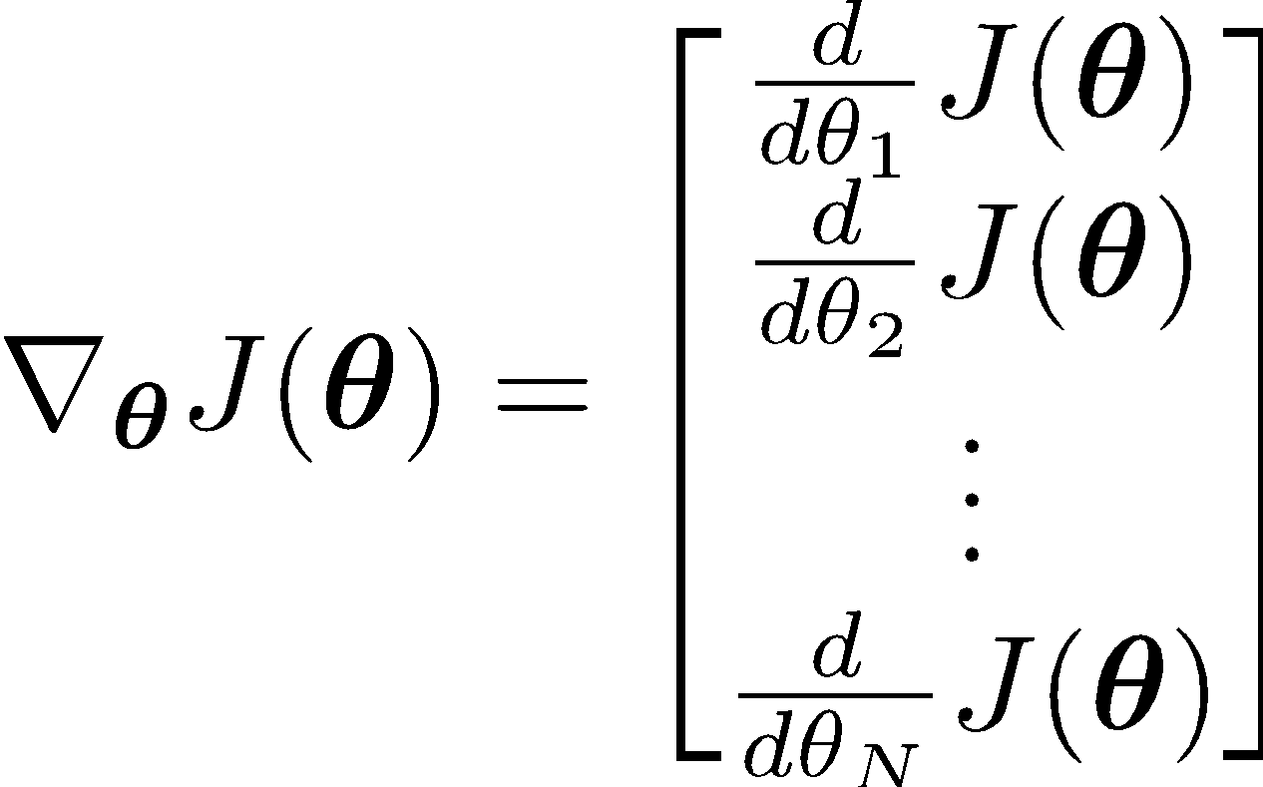
Gradient Descent
In order to apply GD to Linear Regression all we need is the gradient of the objective function (i.e. vector of partial derivatives).

Slide 42
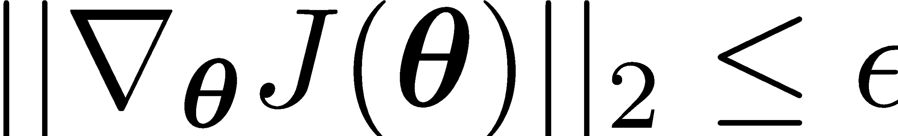
Gradient Descent
There are many possible ways to detect convergence. For example, we could check whether the L2 norm of the gradient is below some small tolerance.
Alternatively we could check that the reduction in the objective function from one iteration to the next is small.

Slide 43
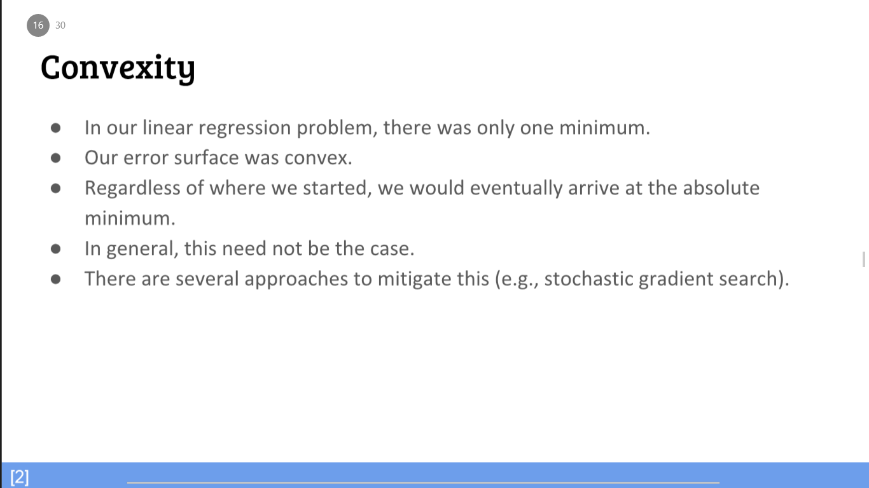

Slide 44
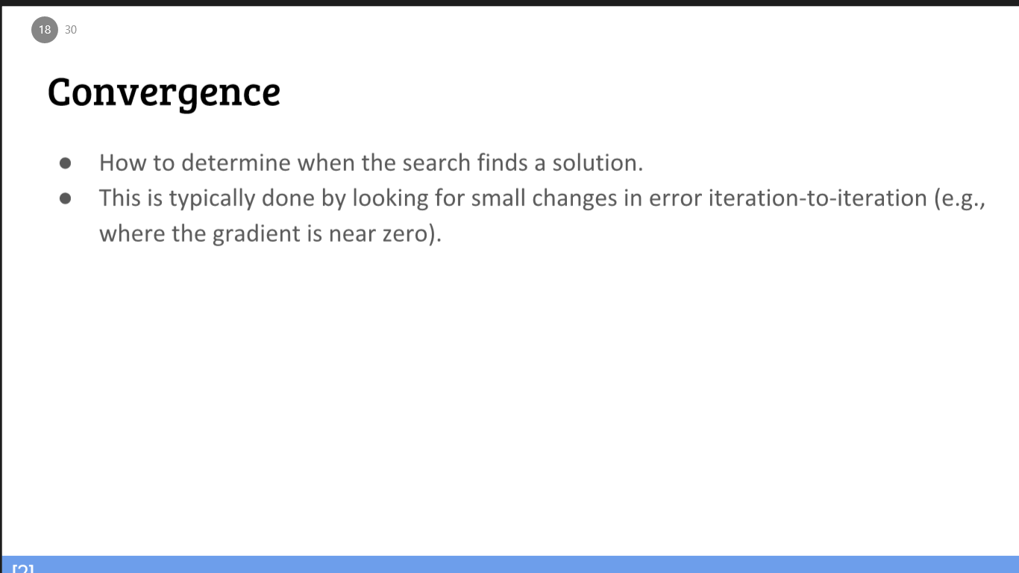

Slide 45
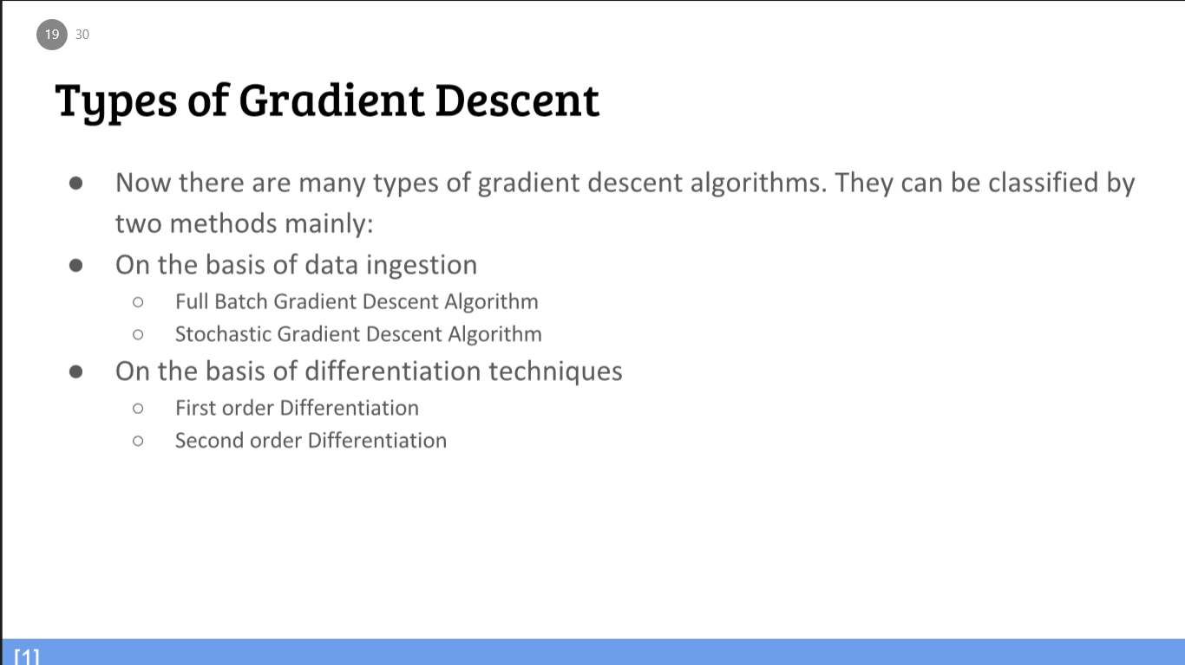

Slide 46
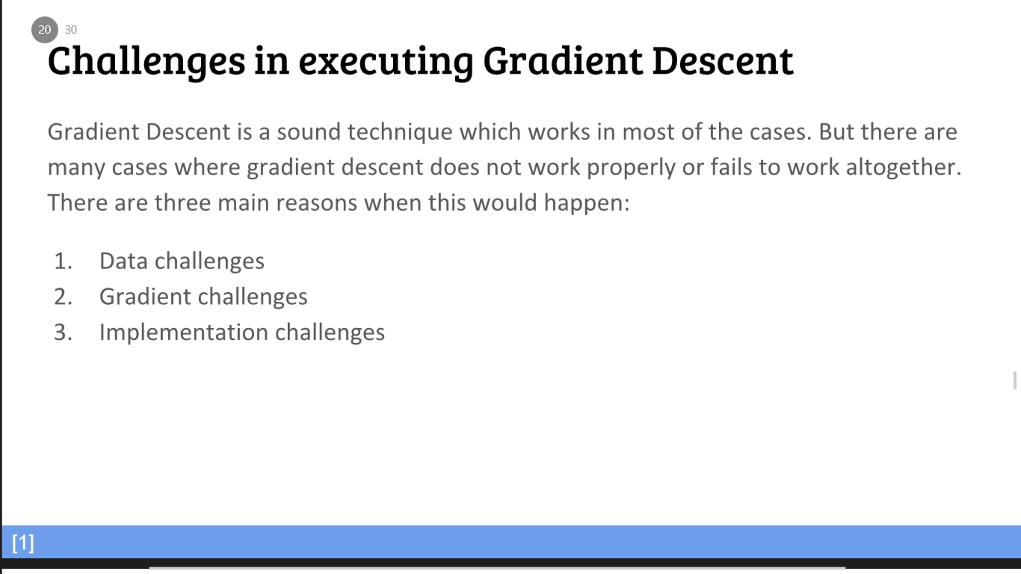

Slide 47
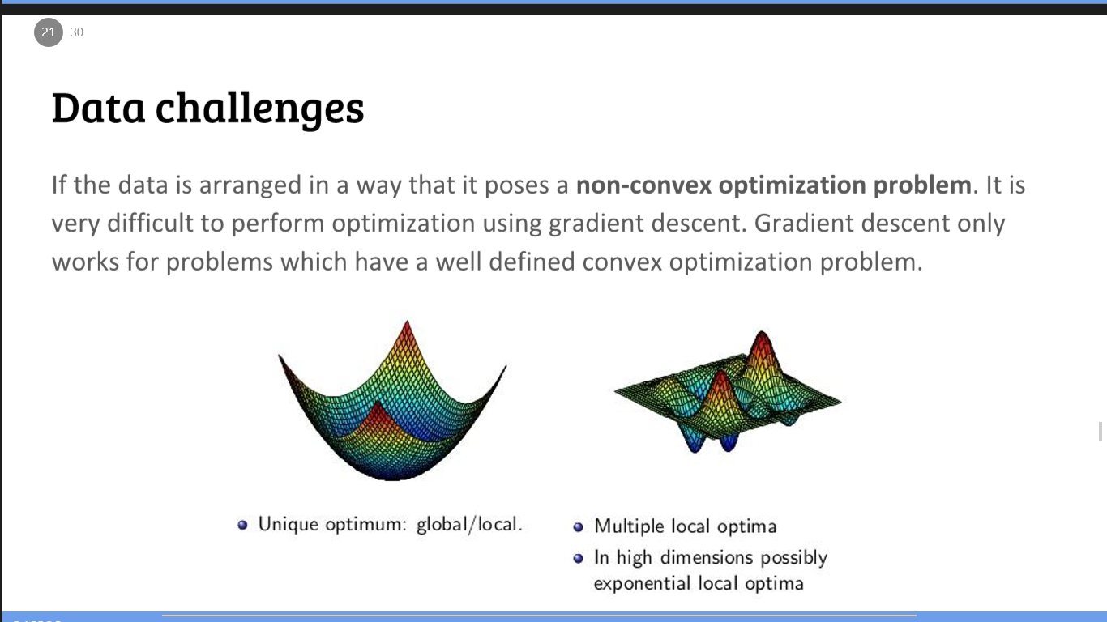

Slide 48
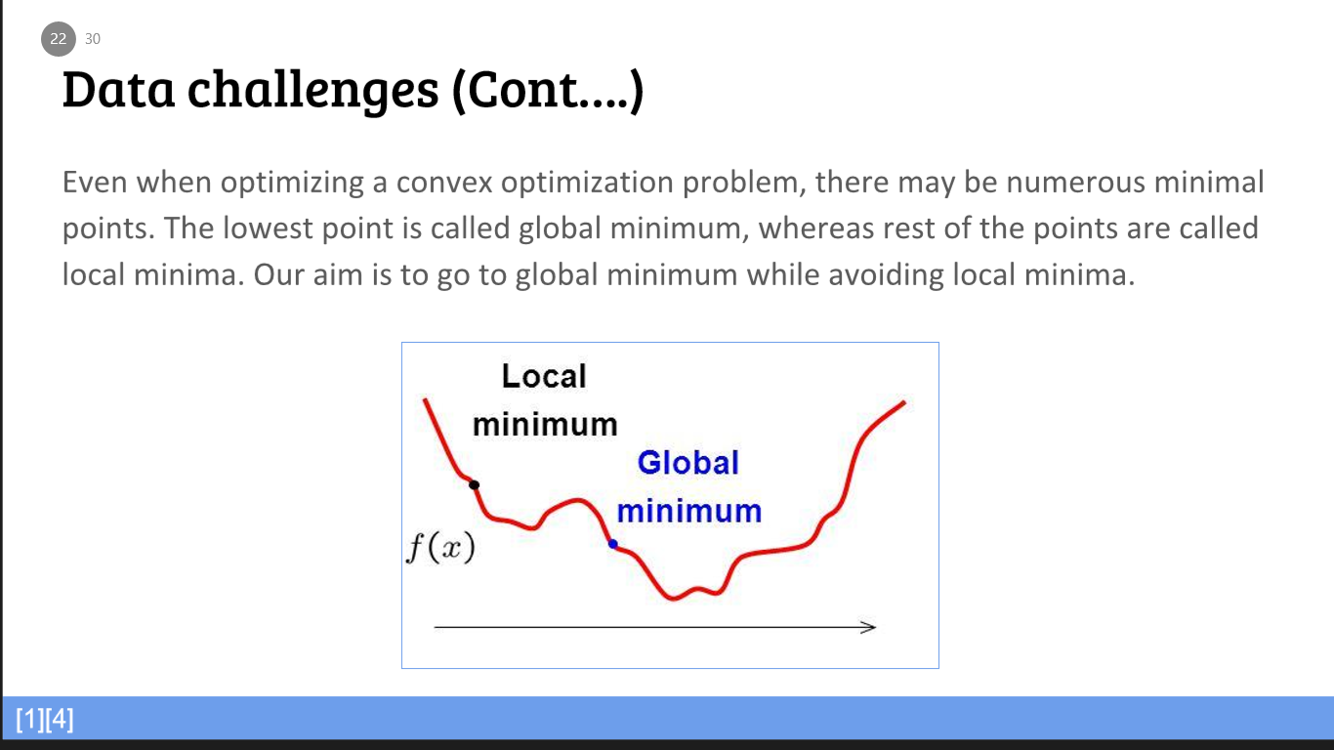

Slide 49
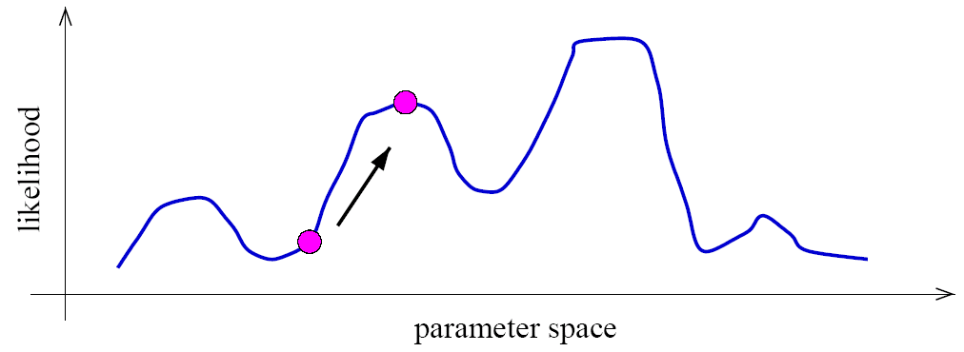
Example: your favorite EM instance
As an example, a mixture model induces a multi-modal likelihood.
Hence gradient ascent can only find a local maximum.

Slide 50
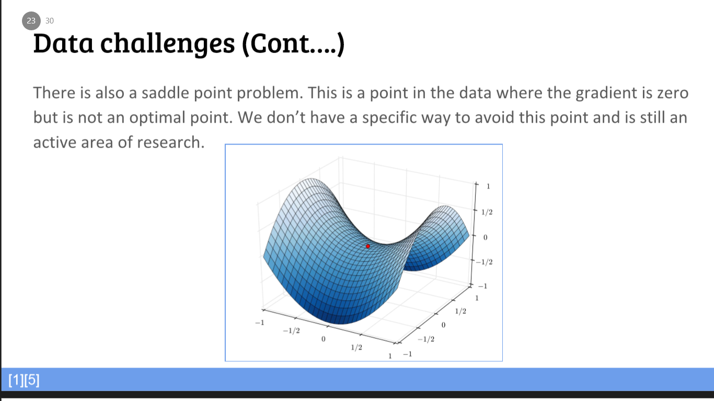

Slide 51
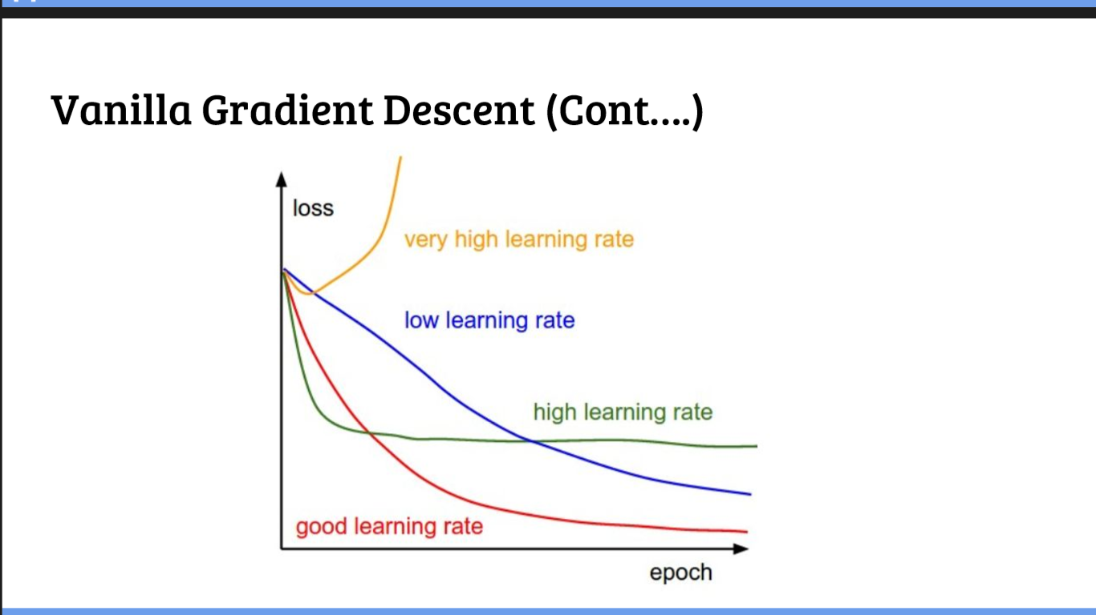

Slide 52
BACKPROPAGATION

Slide 53
What is Backprop ?
Backpropagation is the most common method for training a neural network.
Burn it into your mental firmware!!

Slide 54
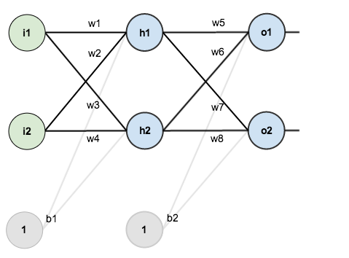
Basic Structure
Credit: Matt Mazur

Slide 55

Values to work with
In order to have some numbers to work with, here are the initial weights, the biases, and training inputs/outputs:

Slide 56
Backpropagation Goal
The goal of backpropagation is to optimize the weights so that the neural network can learn how to correctly map arbitrary inputs to outputs.

Slide 57
Forward Pass
We figure out the total net input to each hidden layer neuron, squash the total net input using an activation function (here we use the logistic function), then repeat the process with the output layer neurons

Slide 58

Forward Pass (Cont…)
Here’s how we calculate the total net input for :
Here’s how we calculate the total net input for :

Slide 59

Forward Pass (Cont…)

Slide 60

Error Calculation – Mean Squared Error
Target
Target

Slide 61
The Backward Pass
Our goal with backpropagation is to update each of the weights in the network so that they cause the actual output to be closer the target output, thereby minimizing the error for each output neuron and the network as a whole.

Slide 62

The Backward Pass (Cont…)

Slide 63

The Backward Pass (Cont…)

Slide 64

The Backward Pass (Cont…)

Slide 65

The Backward Pass (Cont…)

Slide 66


Slide 67

The Backward Pass (Cont…)

Slide 68

The Backward Pass (Cont…)

Slide 69

The Backward Pass (Cont…)

Slide 70

The Backward Pass (Cont…)

Slide 71

The Backward Pass (Cont…)

Slide 72

The Backward Pass (Cont…)

Slide 73

The Backward Pass (Cont…)

Slide 74
References
Machine Learning by Tom Mitchell

